Slide 1
MANOVA
David Mukajanga

Slide 2
What is it?
It is a dependence technique most suitable when you have non-metric groups in the independent variable, looking to know if they cause meaningful difference in the combination of several metric dependent variables.
The goal of the analysis is to evaluate the effect that the belongingness to a certain group within the population of interest results to a meaningful difference on the outcome of the several dependent variables, e.g. Whether belonging to jobs of different status (Blue Coat, White Coat etc.) influenced hours spent out from home for entertainment and the amount of money spent on alcohol.
Pre-cursor to this is ANOVA when there is only one dependent variable and 2 or more groups of an independent variable (generalizable case) and t-tests when you have only one dependent variable and 2 groups in the independent variable (Un-generalizable specific cases).

Slide 3
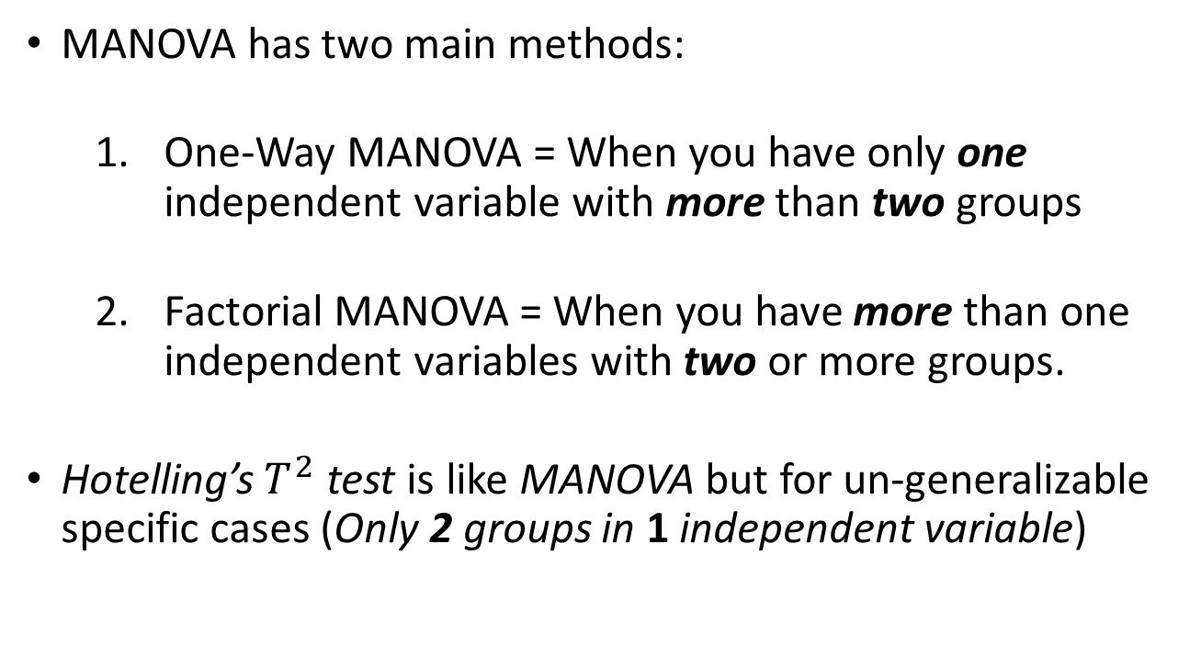
Cont..
MANOVA has two main methods:
One-Way MANOVA = When you have only one independent variable with more than two groups
Factorial MANOVA = When you have more than one independent variables with two or more groups.
Hotelling’s${ T}^{2}$ test is like MANOVA but for un-generalizable specific cases (Only 2 groups in 1 independent variable)

Slide 4
Why is It So Useful?
Because:
It can find the effect of the groups on several dependent variables as a variate;
In the example stated previously, the two metrics of the hours spent away from home and amount of money spent on liquor can be combined and be measured as a variate under the name ‘Level of Contentment’ or something like that. This is good considering the fact that by measuring each dependent variable separately .i.e ANOVA, there are some combined effects that might be left un-explained by the model.
The variate of the dependent variables that is produced is the one that optimally differentiate best the groups in independent variable.
It also reduces the probability of the TYPE I error (rejecting a true null hypothesis) that’s usually very probable in conducting several separate univariate t-tests.

Slide 5
Interpreting The Test Statistics
This analysis has 4 main test statistics named:
Pillai’s Criterion:
It is the most robust. It can prevent the researcher from making the TYPE I error rate even if the assumption of equality of the covariance matrix is violated.
It is interpreted as any value closer to zero showing a little influence of groups of the independent variable (s) to the variate of the dependent variables.
Wilk’s Lambda:
It is the opposite of the Pillai’s Criterion and all the remaining test statistics in-terms of interpretations, where by any value closer to zero shows a significant influence of groups of the independent variables in the variate of the dependent variables.

Slide 6
Test Statistics Continuing
The remaining two are the Hotelling’s Trace and the Roy’s Largest Root. These follow a same pattern of interpretation as the Pillai’s Criterion but some of them are very sensitive to violations in assumptions. So they are not very popular.
In interpreting the test statistics, just go to the second row that has the independent variables and read the values from there. The first raw, Intercept, is not really of any importance.

Slide 7
According to Hair et al (2003), the goal of MANOVA is to identify non-metric variables that cause a greatest differences among a set of dependent variables that are metric.

